Slide 1
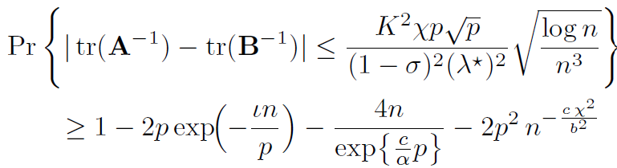
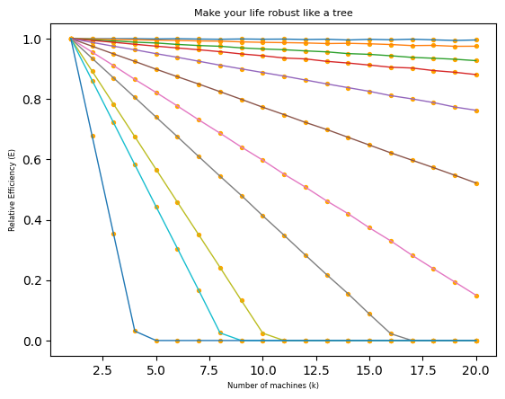




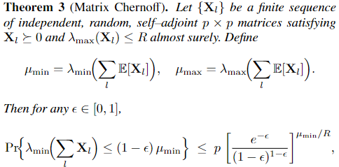
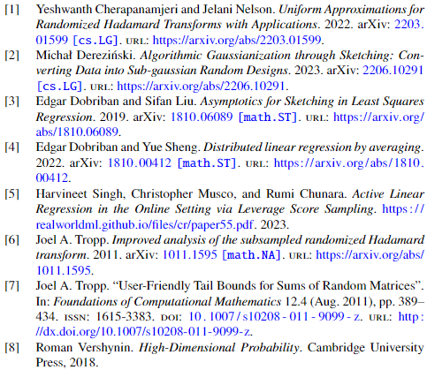


澳門大學科技學院榮譽榜頒獎典禮暨畢業設計展覽2025
FST Graduation Award Ceremony & Project Exhibition
The Merits of Randomized Hadamard Transform in Distributed Regression via Partitioned Machines
Yishu Yang, dc12828@um.edu.mo, MAT(SDS), FST
Background / Introduction
The computation complexity of OLS regression would be extremely larger when the dimension of rows and columns $n, p→∞$. One common intuition is to do distributed regression on several machines with partitioned row data. Our contribution is that using Hadamard Randomized Transform before partitions could make optimal relative efficiency of global OLS estimator to distributed OLS estimator tends to $1$ as $n, p→∞.$ We use data generated from Gaussian mixture models to illustrate the results.
Problem
The classical least squares problem is to solve:
The computation is heavy when the data matrix is very large. The problem can be sped up through distributed machines where the naïve approach is to aggregate the local least squares via weighted average. When assuming gaussian noise for linear models, the relative statistical efficiency has been studied in [4] and given as
where the data in each machine are
The optimal efficiency above is achieved under specific choices of weights in the averaged solutions, which are not available directly. Moreover, this can be much smaller than one when the data exhibits strong heterogeneity and the local data are ill-conditioned.
Methodology
We aim to utilize the statistical properties of Hadamard transformation [1] which can “smooth” the data so that they are closer to be uniformly distributed. Mathematically, we can achieve the following:
where $\tilde{X}=H_{n}DX$ is being Hadamard Randomized Transformed. The proof uses some fundamental concentration inequalities and the following matrix concentration result [8]:
The following are some technical assumptions:
Under these assumptions, denoting
we can use the following bound to ensure that the error is negligible with probability tending to one:
Our above finding has clear conditioning for the relative growth of $p$ compared to $n$, which is required to let the probability on the right side to converge to $0$ asymptotically.
Findings / Conclusion
We see that the Randomized Hadamard Transform (RHT) flatten the variance and make the relative efficiency to be $one$ as expected. And this relative efficiency decays as $p$ is growing towards linear growth of $n$.
So, if you want to realize your own expectation, make your life robust like the root of a tree first.
Future Work
We could further more analyze the case when $p$ is linear growth of $n$, i.e. $p =θn$ where $θ$ is an absolute constant to support our simulation that the asymptotical relative efficiency $E$ would not approaching $1$ anymore.
Acknowledgements
Thank Prof. Zhixiang Zhang, my supervisor. Thank Prof. Zhi Liu, my reference recommender. Thank Prof. Lihu Xu, my reference recommender. Thank all the dedicated researchers in the field of sketching. I love you, my grandma, alive or dead.
References
35th Anniversary Celebration of Faculty of Science and Technology of University of Macau

